Slide 1
Mechanisms and Robotics DE ES ZG561
Lecture-12

Slide 2
Contents
Lagrange Euler Dynamic Model Algorithm
R-R Manipulator

Slide 3
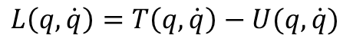
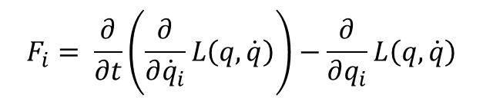
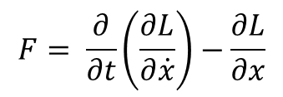
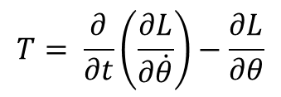
Lagrange Euler Dynamic Model
Lagrangian of a mechanical system is given by
$$L\left(q,\dot{q}\right)=T\left(q,\dot{q}\right)−U(q,\dot{q})$$
L = K - P
$$F_{i}= \frac{∂}{∂t}\left(\frac{∂}{∂{\dot{q}}_{i}}L\left(q,\dot{q}\right)\right)−\frac{∂}{∂q_{i}}L\left(q,\dot{q}\right)$$
$$T= \frac{∂}{∂t}\left(\frac{∂L}{∂\dot{θ}}\right)−\frac{∂L}{∂θ}$$
Fi is the generalized force acting on the
I th joint.
It is residual for left after the effects of inertia and gravity have been removed.
$$F= \frac{∂}{∂t}\left(\frac{∂L}{∂\dot{x}}\right)−\frac{∂L}{∂x}$$

Slide 4
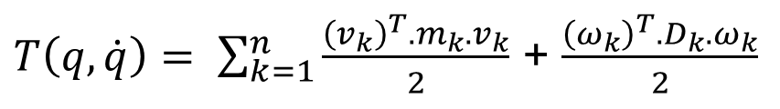
Lagrange Euler Dynamic Model
The total kinetic energy of the arm is the sum of the kinetic energies of its links
$T\left(q,\dot{q}\right)= \sum_{k=1}^{n}{\frac{{\left(v_{k}\right)}^{T}{{.m}_{k}.v}_{k}}{2}}$ + $\frac{{\left(ω_{k}\right)}^{T}{{.D}_{k}.ω}_{k}}{2}$
$ω_{k}$ - is the angular velocity about the center of mass of the kth link expressed
with respect to the base frame
$v_{k}$ - is the linear velocity about the center of mass of the kth link expressed
with respect to the base frame
$D_{k}$ - is the Inertia tensor about the center of mass of the kth link expressed
with respect to the base frame

Slide 5
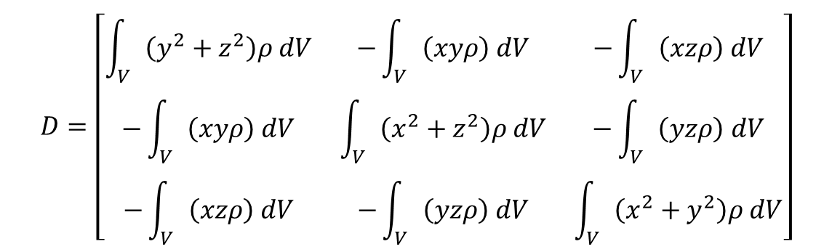
Link Inertia Tensor
An inertia tensor is a 3X3 matrix which characterizes the distribution of mass of a rigid object.
To express inertia tensor with respect to the base coordinate frame, we first consider the case of representing an inertia tensor of a rigid object with respect of a frame whose origin is located at the centre of mass of the object
Let ρ denote the mass density of the rigid object and let V represent the volume occupied by the object.
Then the inertia tensor of the object about its centre of mass expressed with respect to the coordinate frame located at the centre of mass is
$$D=\left[\begin{matrix}\int_{V}{\left(y^{2}+z^{2}\right)ρ dV} & −\int_{V}{\left(xyρ\right) dV} & −\int_{V}{\left(xzρ\right) dV} \\ −\int_{V}{\left(xyρ\right) dV} & \int_{V}{\left(x^{2}+z^{2}\right)ρ dV} & −\int_{V}{\left(yzρ\right) dV} \\ −\int_{V}{\left(xzρ\right) dV} & −\int_{V}{\left(yzρ\right) dV} & \int_{V}{\left(x^{2}+y^{2}\right)ρ dV}\end{matrix}\right]$$
The three diagonal elements are called Moments of inertia.
The off-diagonal elements are called Products of Inertia.

Slide 6
Product of Inertia
Product of Inertia
A quantity that characterizes the mass distribution in a body or mechanical system. Products of inertia are the sums of the products formed by multiplying the mass m_{k} of each point of the body or system by the product of two of the coordinates x_{k}, y_{k}, z_{k} of the point
The values of the products of inertia depend on the orientations of the coordinate axes. For every point of the body or system, there exist at least three mutually perpendicular axes, called the principal axes of inertia, for which the products of inertia are equal to zero.
Products of inertia of a body are measures of symmetry
If a particular plane is a plane of symmetry, then the products of inertia associated with any axis perpendicular to that plane are zero.

Slide 7
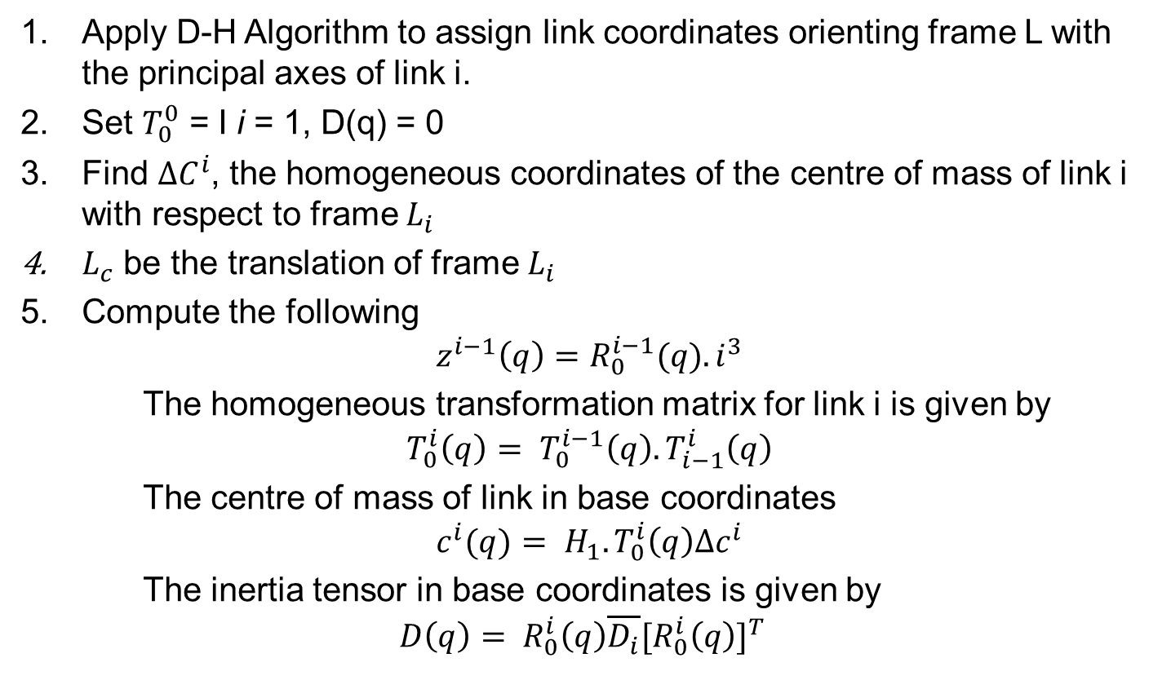
Lagrange-Euler Dynamic Model Algorithm
Apply D-H Algorithm to assign link coordinates orienting frame L with the principal axes of link i.
Set $T_{0}^{0}$ = I i = 1, D(q) = 0
Find $∆C^{i}$, the homogeneous coordinates of the centre of mass of link i with respect to frame $L_{i}$
$L_{c}$ be the translation of frame $L_{i}$
Compute the following
$$z^{i−1}\left(q\right)=R_{0}^{i−1}(q). i^{3}$$
The homogeneous transformation matrix for link i is given by
$$T_{0}^{i}\left(q\right)= T_{0}^{i−1}\left(q\right).T_{i−1}^{i}\left(q\right)$$
The centre of mass of link in base coordinates
$$c^{i}(q)= H_{1}.T_{0}^{i}\left(q\right)∆c^{i}$$
The inertia tensor in base coordinates is given by
$$D\left(q\right)= R_{0}^{i}\left(q\right)\overline{D_{i}}{[R_{0}^{i}\left(q\right)]}^{T}$$

Slide 8
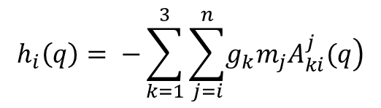
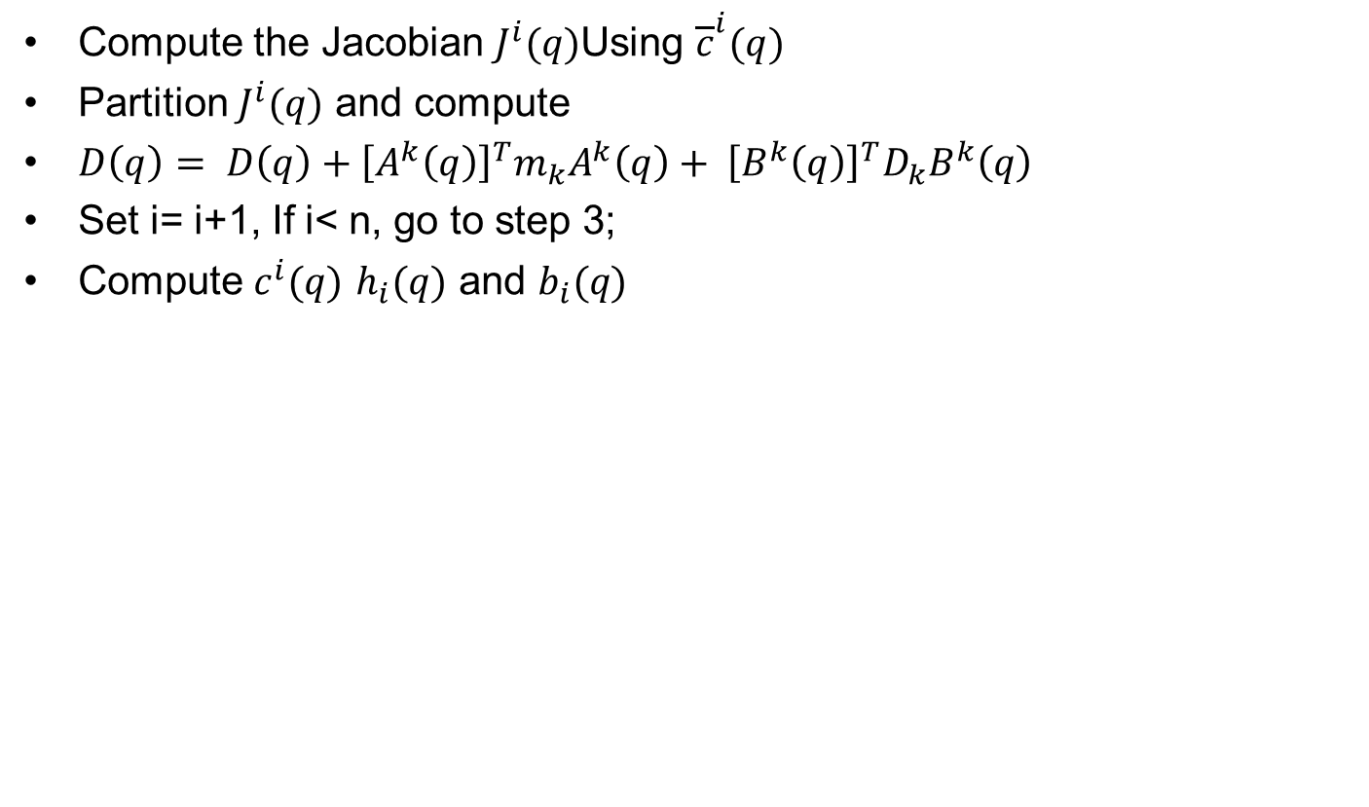
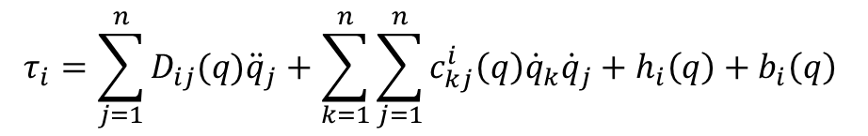
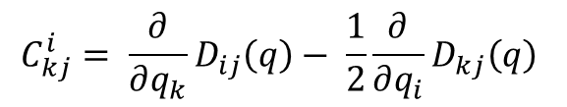
Lagrange-Euler Dynamic Model Algorithm
Compute the Jacobian $J^{i}(q)$Using ${\overline{c}}^{i}(q)$
Partition $J^{i}(q)$ and compute
$D\left(q\right)= D\left(q\right)+{\left[A^{k}\left(q\right)\right]}^{T}m_{k}A^{k}\left(q\right)+ {\left[B^{k}\left(q\right)\right]}^{T}D_{k}B^{k}\left(q\right)$
Set i= i+1, If i< n, go to step 3;
Compute $c^{i}(q)$ $h_{i}(q)$ and $b_{i}(q)$
$$C_{kj}^{i}= \frac{∂}{∂q_{k}}D_{ij}\left(q\right)− \frac{1}{2}\frac{∂}{∂q_{i}}D_{kj}\left(q\right)$$
$$h_{i}\left(q\right)= −\sum_{k=1}^{3}{\sum_{j=i}^{n}{\left.g_{k}m_{j}A_{ki}^{j}(q\right)}}$$
$$τ_{i}=\sum_{j=1}^{n}{D_{ij}(q){\ddot{q}}_{j}}+\sum_{k=1}^{n}{\sum_{j=1}^{n}{c_{kj}^{i}\left(q\right){\dot{q}}_{k}{\dot{q}}_{j}}+h_{i}\left(q\right)+b_{i}\left(q\right) }$$

Slide 9
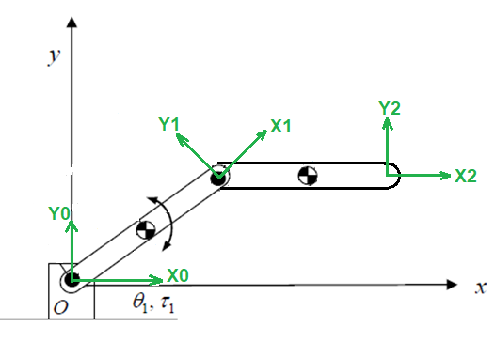
Lagrange Euler Dynamic Model of a two dof RR Manipulator
Assumption: Two links are thin cylinders of mass m1 and m2

Slide 10
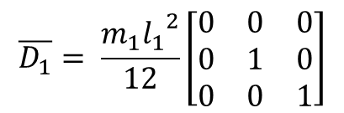
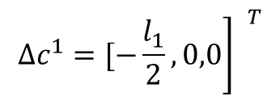
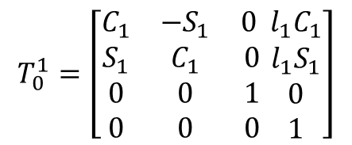
Lagrange Euler Dynamic Model of a two dof RR Manipulator
The centre of mass of link 1 in frame L1 coordinates
If D1 is the inertia tensor of link l1 about centre of mass. The axis of Lc is aligned with the principal axis of the link.
The homogeneous coordinate transformation matrix is given as
$${\left.∆c^{1}=[−\frac{l_{1}}{2},0,0\right] }^{T}$$
$$\overline{D_{1}}= \frac{m_{1}{l_{1}}^{2}}{12}\left[\begin{matrix}0 & 0 & 0 \\ 0 & 1 & 0 \\ 0 & 0 & 1\end{matrix}\right]$$
$$T_{0}^{1}=\left[\begin{matrix}C_{1} & {−S}_{1} & 0 \\ S_{1} & C_{1} & 0 \\ \begin{matrix}0 \\ 0\end{matrix} & \begin{matrix}0 \\ 0\end{matrix} & \begin{matrix}1 \\ 0\end{matrix}\end{matrix} \begin{matrix}l_{1}C_{1} \\ l_{1}S_{1} \\ \begin{matrix}0 \\ 1\end{matrix}\end{matrix}\right]$$

Slide 11
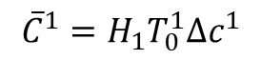
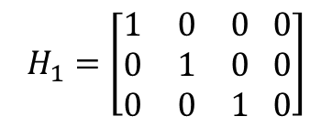
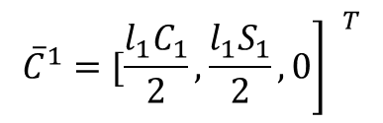
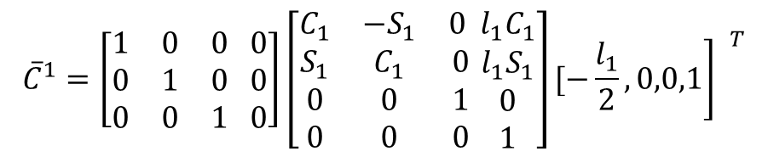
Lagrange Euler Dynamic Model of a two dof RR Manipulator
The centre of mass of link 1 in base coordinates is given as
$${\overline{C}}^{1}=H_{1}T_{0}^{1}∆c^{1}$$
$$H_{1}=\left[\begin{matrix}1 & 0 & 0 0 \\ 0 & 1 & 0 0 \\ 0 & 0 & 1 0\end{matrix}\right]$$
$${\overline{C}}^{1}=\left[\begin{matrix}1 & 0 & 0 0 \\ 0 & 1 & 0 0 \\ 0 & 0 & 1 0\end{matrix}\right]\left[\begin{matrix}C_{1} & {−S}_{1} & 0 \\ S_{1} & C_{1} & 0 \\ \begin{matrix}0 \\ 0\end{matrix} & \begin{matrix}0 \\ 0\end{matrix} & \begin{matrix}1 \\ 0\end{matrix}\end{matrix} \begin{matrix}l_{1}C_{1} \\ l_{1}S_{1} \\ \begin{matrix}0 \\ 1\end{matrix}\end{matrix}\right]{\left.[−\frac{l_{1}}{2},0,0,1\right] }^{T}$$
$${\left.{\overline{C}}^{1}=[\frac{l_{1}C_{1}}{2},\frac{l_{1}S_{1}}{2},0\right] }^{T}$$

Slide 12
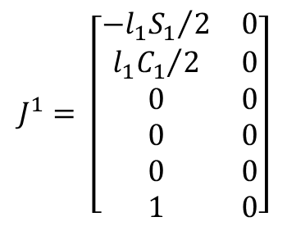
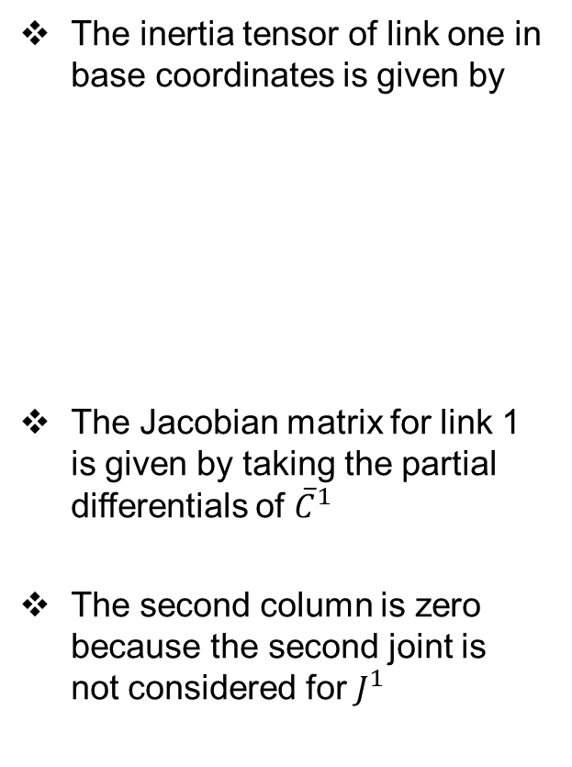
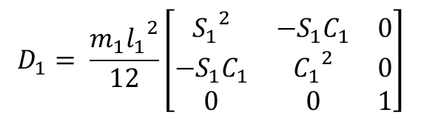
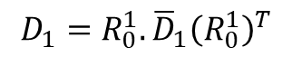
Lagrange Euler Dynamic Model of a two dof RR Manipulator
The inertia tensor of link one in base coordinates is given by
The Jacobian matrix for link 1 is given by taking the partial differentials of ${\overline{C}}^{1}$
The second column is zero because the second joint is not considered for $J^{1}$
$$D_{1}={R_{0}^{1}.\overline{D}}_{1}{\left(R_{0}^{1}\right)}^{T}$$
$$D_{1}= \frac{m_{1}{l_{1}}^{2}}{12}\left[\begin{matrix}{S_{1}}^{2} & −S_{1}C_{1} & 0 \\ −S_{1}C_{1} & {C_{1}}^{2} & 0 \\ 0 & 0 & 1\end{matrix}\right]$$
$$J^{1}= \left[\begin{matrix}{{{−l}_{1}S}_{1}}/2 & 0 \\ {{l_{1}C}_{1}}/2 & 0 \\ 0 & 0 \\ 0 & 0 \\ 0 & 0 \\ 1 & 0\end{matrix}\right]$$

Slide 13
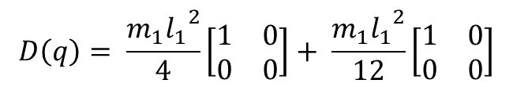
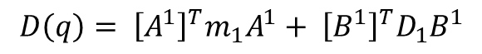
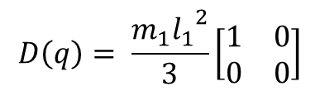
Lagrange Euler Dynamic Model of a two dof RR Manipulator
Partitioning the Jacobian in to A and B, the contribution to the manipulator inertia tensor from link 1 Is given as
manipulator inertia tensor from link 1
$$D\left(q\right)= {\left[A^{1}\right]}^{T}m_{1}A^{1}+ {\left[B^{1}\right]}^{T}D_{1}B^{1}$$
$$D\left(q\right)= \frac{m_{1}{l_{1}}^{2}}{4}\left[\begin{matrix}1 & 0 \\ 0 & 0\end{matrix}\right]+ \frac{m_{1}{l_{1}}^{2}}{12}\left[\begin{matrix}1 & 0 \\ 0 & 0\end{matrix}\right]$$
$$D\left(q\right)= \frac{m_{1}{l_{1}}^{2}}{3}\left[\begin{matrix}1 & 0 \\ 0 & 0\end{matrix}\right]$$

Slide 14
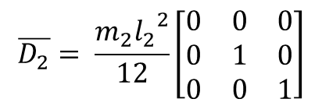
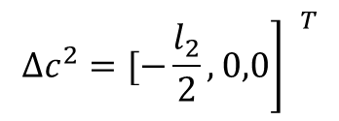
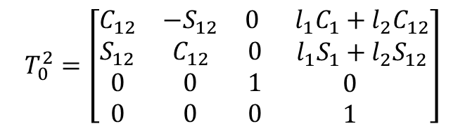
Lagrange Euler Dynamic Model of a two dof RR Manipulator
The centre of mass of link 2 in frame L2 coordinates
If D2 is the inertia tensor of link l2 about centre of mass. The axis of Lc is aligned with the principal axis of the link.
The homogeneous coordinate transformation matrix for link 2 is given as
$${\left.∆c^{2}=[−\frac{l_{2}}{2},0,0\right] }^{T}$$
$$\overline{D_{2}}= \frac{m_{2}{l_{2}}^{2}}{12}\left[\begin{matrix}0 & 0 & 0 \\ 0 & 1 & 0 \\ 0 & 0 & 1\end{matrix}\right]$$
$$T_{0}^{2}=\left[\begin{matrix}C_{12} & {−S}_{12} & 0 \\ S_{12} & C_{12} & 0 \\ \begin{matrix}0 \\ 0\end{matrix} & \begin{matrix}0 \\ 0\end{matrix} & \begin{matrix}1 \\ 0\end{matrix}\end{matrix} \begin{matrix}{ l}_{1}C_{1}+l_{2}C_{12} \\ { l}_{1}S_{1}+l_{2}S_{12} \\ \begin{matrix}0 \\ 1\end{matrix}\end{matrix}\right]$$

Slide 15
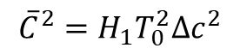
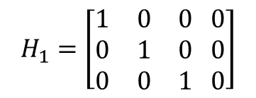
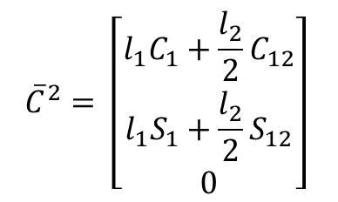
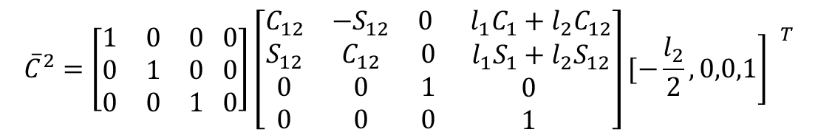
Lagrange Euler Dynamic Model of a two dof RR Manipulator
The centre of mass of link 2 from the base coordinates is given by
$${\overline{C}}^{2}=H_{1}T_{0}^{2}∆c^{2}$$
$$H_{1}=\left[\begin{matrix}1 & 0 & 0 0 \\ 0 & 1 & 0 0 \\ 0 & 0 & 1 0\end{matrix}\right]$$
$${\overline{C}}^{2}=\left[\begin{matrix}1 & 0 & 0 0 \\ 0 & 1 & 0 0 \\ 0 & 0 & 1 0\end{matrix}\right]\left[\begin{matrix}C_{12} & {−S}_{12} & 0 \\ S_{12} & C_{12} & 0 \\ \begin{matrix}0 \\ 0\end{matrix} & \begin{matrix}0 \\ 0\end{matrix} & \begin{matrix}1 \\ 0\end{matrix}\end{matrix} \begin{matrix}{ l}_{1}C_{1}+l_{2}C_{12} \\ { l}_{1}S_{1}+l_{2}S_{12} \\ \begin{matrix}0 \\ 1\end{matrix}\end{matrix}\right]{\left.[−\frac{l_{2}}{2},0,0,1\right] }^{T}$$
$${\overline{C}}^{2}= \left[\begin{matrix}l_{1}C_{1}+\frac{l_{2}}{2}C_{12} \\ l_{1}S_{1}+\frac{l_{2}}{2}S_{12} \\ 0\end{matrix}\right]$$

Slide 16
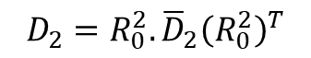
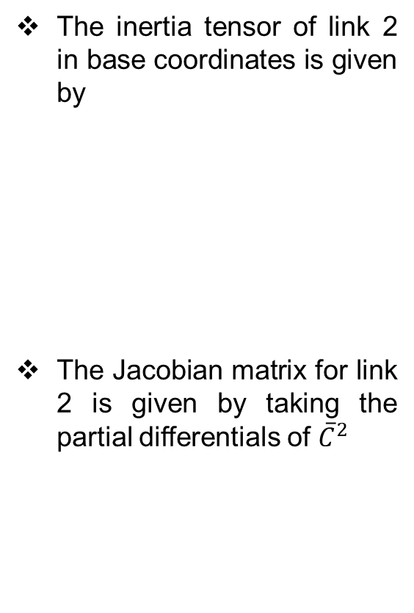
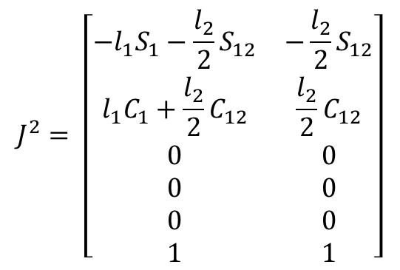
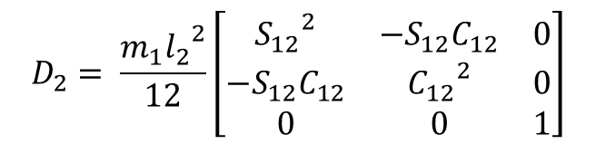
Lagrange Euler Dynamic Model of a two dof RR Manipulator
The inertia tensor of link 2 in base coordinates is given by
The Jacobian matrix for link 2 is given by taking the partial differentials of ${\overline{C}}^{2}$
$$D_{2}={R_{0}^{2}.\overline{D}}_{2}{\left(R_{0}^{2}\right)}^{T}$$
$$D_{2}= \frac{m_{1}{l_{2}}^{2}}{12}\left[\begin{matrix}{S_{12}}^{2} & −S_{12}C_{12} & 0 \\ −S_{12}C_{12} & {C_{12}}^{2} & 0 \\ 0 & 0 & 1\end{matrix}\right]$$
$$J^{2}= \left[\begin{matrix}{{−l}_{1}S}_{1}−{\frac{l_{2}}{2}S}_{12} & −{\frac{l_{2}}{2}S}_{12} \\ {l_{1}C}_{1}+{\frac{l_{2}}{2}C}_{12} & {\frac{l_{2}}{2}C}_{12} \\ 0 & 0 \\ 0 & 0 \\ 0 & 0 \\ 1 & 1\end{matrix}\right]$$

Slide 17
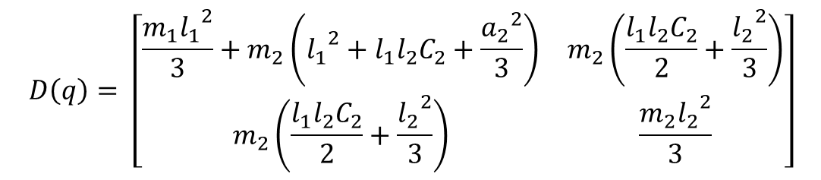
Lagrange Euler Dynamic Model of a two dof RR Manipulator
Partitioning the Jacobian in to A and B, the contribution to the manipulator inertia tensor from link 2 is given as
$$D\left(q\right)= {D\left(q\right)+\left[A^{2}\right]}^{T}m_{2}A^{2}+ {\left[B^{2}\right]}^{T}D_{2}B^{2}$$
$$D\left(q\right)= \left[\begin{matrix}\frac{m_{1}{l_{1}}^{2}}{3}+m_{2}\left({l_{1}}^{2}+l_{1}l_{2}C_{2}+\frac{{a_{2}}^{2}}{3}\right) & m_{2}\left(\frac{l_{1}l_{2}C_{2}}{2}+\frac{{l_{2}}^{2}}{3}\right) \\ m_{2}\left(\frac{l_{1}l_{2}C_{2}}{2}+\frac{{l_{2}}^{2}}{3}\right) & \frac{m_{2}{l_{2}}^{2}}{3}\end{matrix}\right]$$

Slide 18
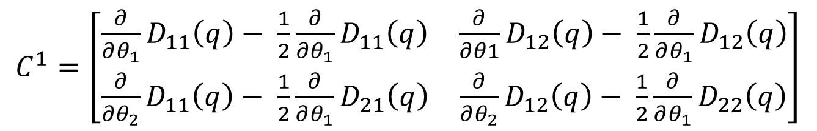
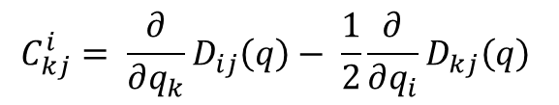
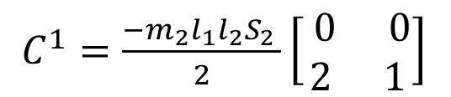
Lagrange Euler Dynamic Model of a two dof RR Manipulator
The velocity coupling matrix is calculated from the following equation
For joint 1, i = 1
$$C_{kj}^{i}= \frac{∂}{∂q_{k}}D_{ij}\left(q\right)− \frac{1}{2}\frac{∂}{∂q_{i}}D_{kj}\left(q\right)$$
$C^{1}=\left[\begin{matrix}\frac{∂}{∂θ_{1}}D_{11}\left(q\right)− \frac{1}{2}\frac{∂}{∂θ_{1}}D_{11}\left(q\right) & \frac{∂}{∂θ1}D_{12}\left(q\right)− \frac{1}{2}\frac{∂}{∂θ_{1}}D_{12}\left(q\right) \\ \frac{∂}{∂θ_{2}}D_{11}\left(q\right)− \frac{1}{2}\frac{∂}{∂θ_{1}}D_{21}\left(q\right) & \frac{∂}{∂θ_{2}}D_{12}\left(q\right)− \frac{1}{2}\frac{∂}{∂θ_{1}}D_{22}\left(q\right)\end{matrix}\right]$
$C^{1}=\frac{{{−m}_{2}l_{1}l_{2}S}_{2 }}{2}\left[\begin{matrix} 0 & 0 \\ 2 & 1\end{matrix}\right]$

Slide 19
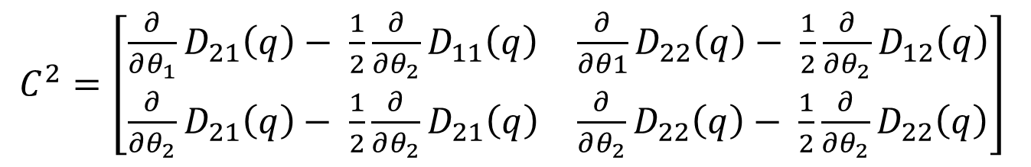
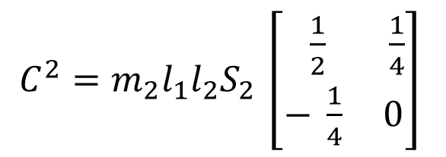
Lagrange Euler Dynamic Model of a two dof RR Manipulator
The velocity coupling matrix is calculated from the following equation
For joint 2, i = 2
$$C_{kj}^{i}= \frac{∂}{∂q_{k}}D_{ij}\left(q\right)− \frac{1}{2}\frac{∂}{∂q_{i}}D_{kj}\left(q\right)$$
$C^{2}=\left[\begin{matrix}\frac{∂}{∂θ_{1}}D_{21}\left(q\right)− \frac{1}{2}\frac{∂}{∂θ_{2}}D_{11}\left(q\right) & \frac{∂}{∂θ1}D_{22}\left(q\right)− \frac{1}{2}\frac{∂}{∂θ_{2}}D_{12}\left(q\right) \\ \frac{∂}{∂θ_{2}}D_{21}\left(q\right)− \frac{1}{2}\frac{∂}{∂θ_{2}}D_{21}\left(q\right) & \frac{∂}{∂θ_{2}}D_{22}\left(q\right)− \frac{1}{2}\frac{∂}{∂θ_{2}}D_{22}\left(q\right)\end{matrix}\right]$
$C^{2}={m_{2}l_{1}l_{2}S}_{2 }\left[\begin{matrix} \frac{1}{2} & \frac{1}{4} \\ − \frac{1}{4} & 0\end{matrix}\right]$

Slide 20
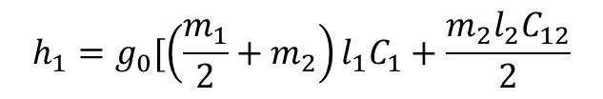
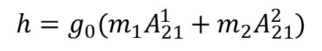
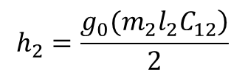
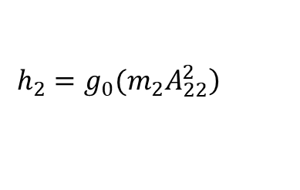
Lagrange Euler Dynamic Model of a two dof RR Manipulator
The potential energy terms are given as
$$h=g_{0}(m_{1}A_{21}^{1}+m_{2}A_{21}^{2})$$
$$h_{1}=g_{0}[\left(\frac{m_{1}}{2}+m_{2}\right)l_{1}C_{1}+\frac{m_{2}l_{2}C_{12}}{2}$$
$$\left.h_{2}=g_{0}(m_{2}A_{22}^{2}\right)$$
$$h_{2}=\frac{\left.g_{0}(m_{2}l_{2}C_{12}\right)}{2}$$

Slide 21
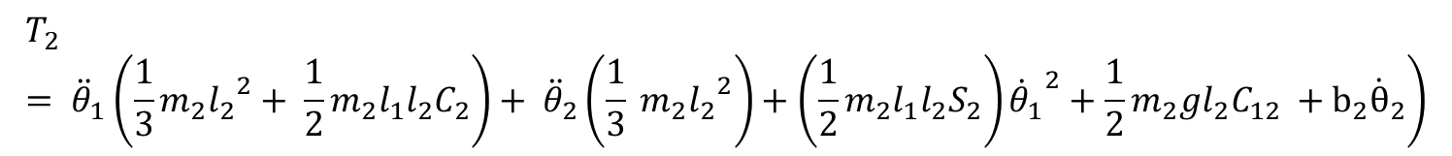
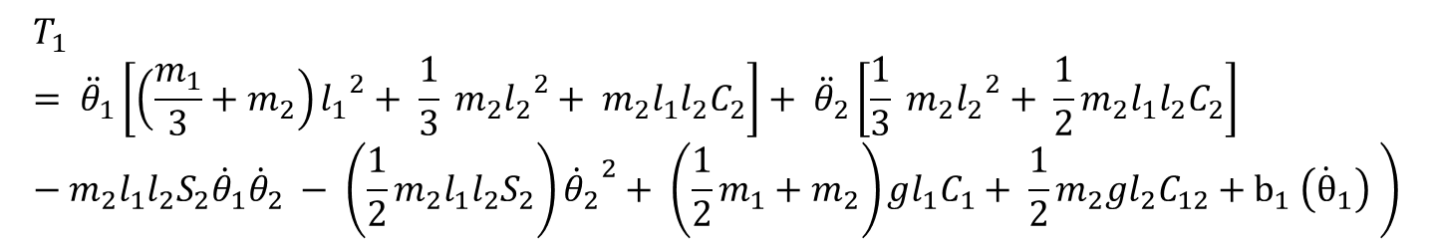
$$\left.T_{1}= {\ddot{θ}}_{1}\left[\left(\frac{m_{1}}{3}+m_{2}\right){l_{1}}^{2}+ \frac{1}{3} m_{2}{l_{2}}^{2}+ m_{2}{l_{1}l}_{2}C_{2}\right]+ {\ddot{θ}}_{2}\left[\frac{1}{3} m_{2}{l_{2}}^{2}+ {\frac{1}{2}m}_{2}{l_{1}l}_{2}C_{2}\right]−m_{2}{l_{1}l}_{2}S_{2}{\dot{θ}}_{1}{\dot{θ}}_{2} − \left({\frac{1}{2}m}_{2}{l_{1}l}_{2}S_{2}\right){{\dot{θ}}_{2}}^{2}+ \left({\frac{1}{2}m}_{1}+m_{2}\right)gl_{1}C_{1}+ \frac{1}{2}m_{2}gl_{2}C_{12}{+ b}_{1}\left({\dot{θ}}_{1}\right) \right)$$
$$\left.T_{2}= {\ddot{θ}}_{1}\left(\frac{1}{3}m_{2}{l_{2}}^{2}+ \frac{1}{2}m_{2}{l_{1}l}_{2}C_{2}\right)+ {\ddot{θ}}_{2}\left(\frac{1}{3} m_{2}{l_{2}}^{2}\right)+\left({\frac{1}{2}m}_{2}{l_{1}l}_{2}S_{2}\right){{\dot{θ}}_{1}}^{2}+\frac{1}{2}m_{2}gl_{2}C_{12} +b_{2}{\dot{θ}}_{2}\right)$$

Slide 22
THANK YOU
The presenter is grateful to the authors of the following textbooks.
Industrial Robotics - Mikell P. Groover
Fundamentals of Robotics – Robert Schilling
Introduction to Robotics Analysis, Control, Applications Saeed B. Niku

